Slide 1

Linear Graphs
Yr 12 Essentials

Slide 2
Opener
Silent Card Shuffle- MAWA Teachers Guide pg 87
You will need to print and cut it prior to lesson.
Instructions can be found in MAWA Text pg 82.

Slide 3
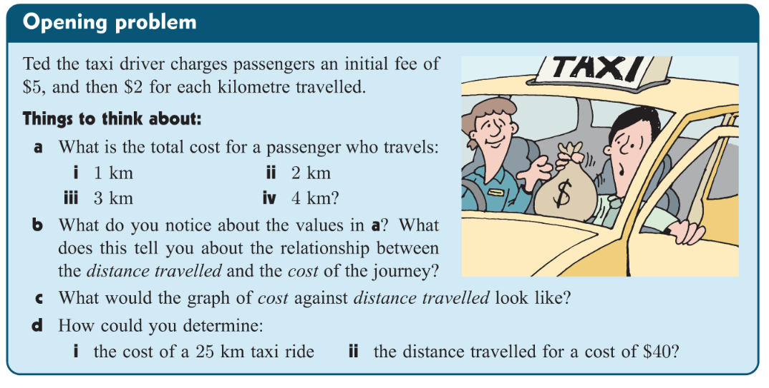
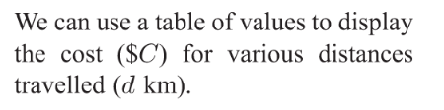
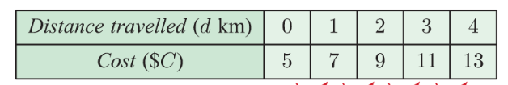

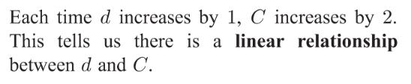
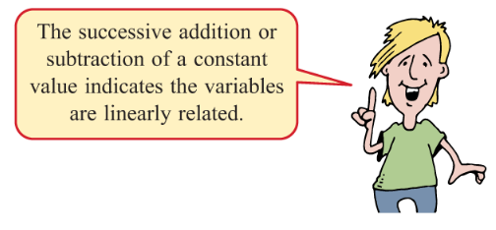

Slide 4
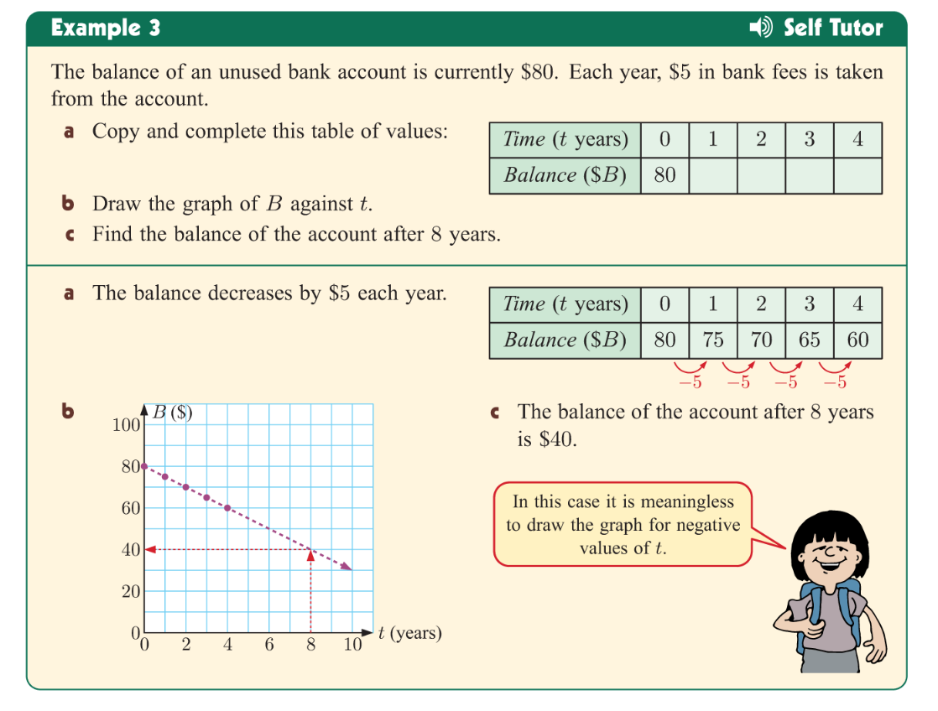
Lets try another one together

Slide 5
Linear Graphing Worksheet
Chapter 23 MAWA Text Example
Pg 83 Exercises 1 – 4
Homework
International Mobile phone Investigation

